Slide 1
DS-302 Engineering Design (final project presentation)
Presenting By:
Aitha Naga Sai Prasanth
Kondeti Rakesh Reddy
Kolukuluri Srikar
Nikhil Krishna Reddy
Gummudala Hymavathi

Slide 2
TrackATool
..............Don’t Forget to Remember.............

Slide 3
Need Identification
In India, there are no reliable existing products for keeping track of the objects.
So, we would like to help dementia people, by making a device which can store the location of their belongings.

Slide 4
User Study:
Our team had consulted doctors Jabalpur Hospital & Johri hospital.
They explained about the problems faced by dementia people due to their forgetfulness.
After that we consulted the dementia care centre to know the further problems faced by them.
There are 9 dementia patients and 5 caretakers in that care centre.
As forgetfulness is primary element in dementia people.
We have asked, “What do you forget usually in your daily life?” and the response is as follows

Slide 5
And we have asked for the places where they are going to spend their most of the time,
They are spending their most of time in either home or office.

Slide 6
Customer Needs:
From our user study, we have derived the following customer needs
Primary: (must)
Objects that would be covered
Medicines, keys, spectacles, books, cards, wallet, etc.
Work places that need be covered
Home, office (for job holders), School (for students).
Range that would be covered is 2-3 m.
Can be used Independently
Secondary: (may/may not)
A reminder for daily activities and medications.

Slide 7
Product Specifications
Wearable Wireless device
Portable and user-friendly
Weights around 120-140 grams
Life span:- long lasting
Power source – rechargeable battery
Shock proof
Water resistant
Cost approximately ~ ₹4000 - ₹5000

Slide 8
Quality Function Deployment (QFD)
In QFD, the bench mark product we have taken is the TrackR.
Scale we have considered,
9 = Strong Strong positive
3 = Moderate Positive
1 = Weak Negative x

Slide 9
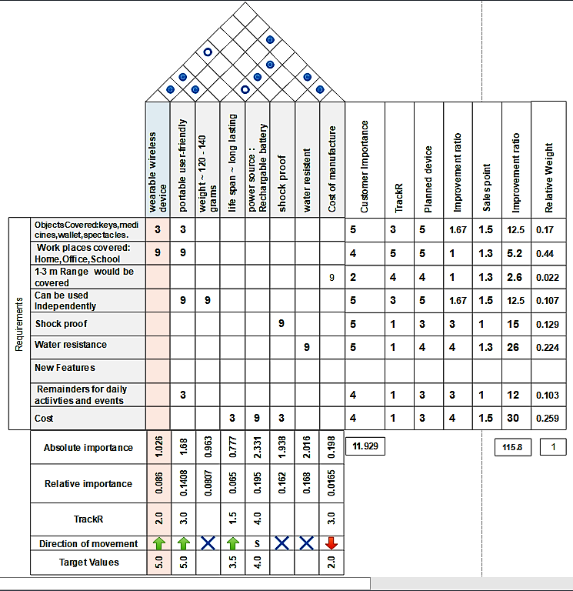

Slide 10
Concept Generation

Slide 11
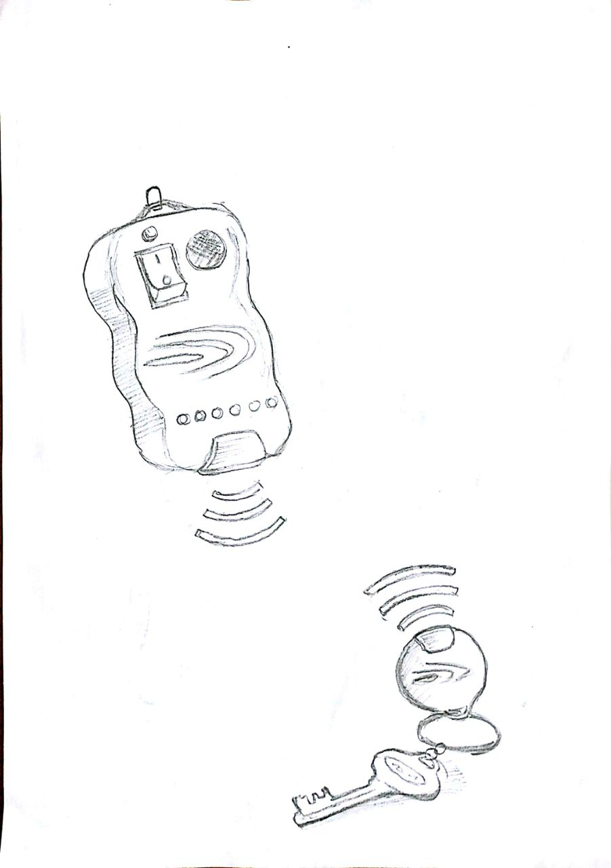
CONCEPT- 1
Concept 1
Every object is attached with a chip.
This chip emits a particular frequency.
Device detects these particular frequency & helps to locate things.

Slide 12
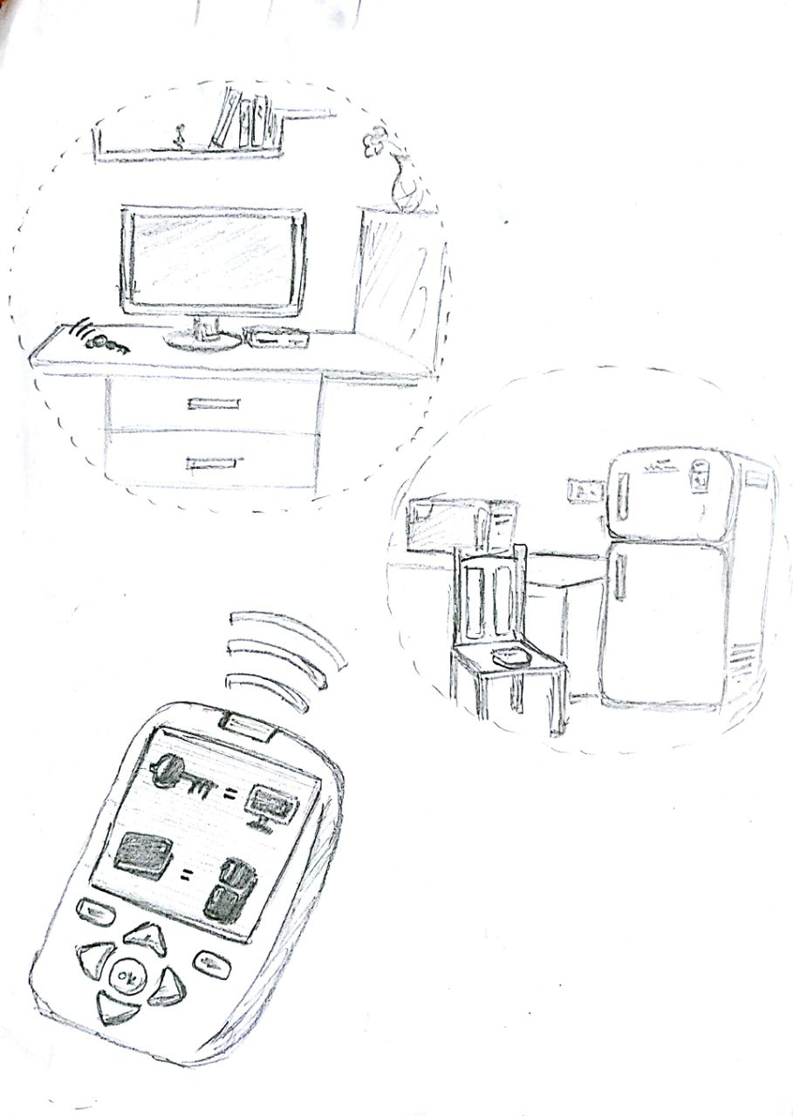
Concept 2
Like a broadcasting telephone a range can be created for a particular reference object
Every object which comes inside this range is identified automatically.

Slide 13
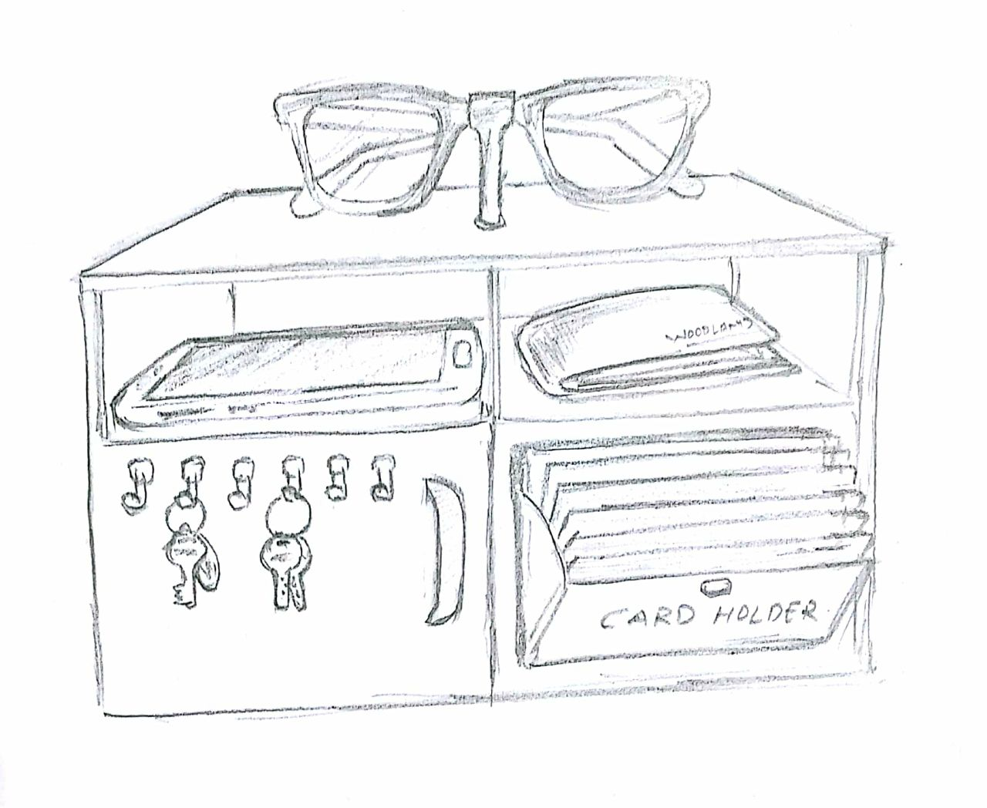
Concept 3
Each and every object ,must be placed in a particular self or box
Time table of the person is fed into this self or box
The self/box notices about things before connecting event

Slide 14
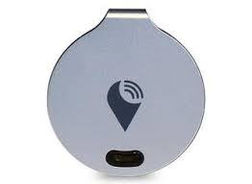
Concept 4
The Cost of present TrackR is 3000/-
Instead of using GPS sensor, we can use Bluetooth module which shows the distance and direction of objects.

Slide 15
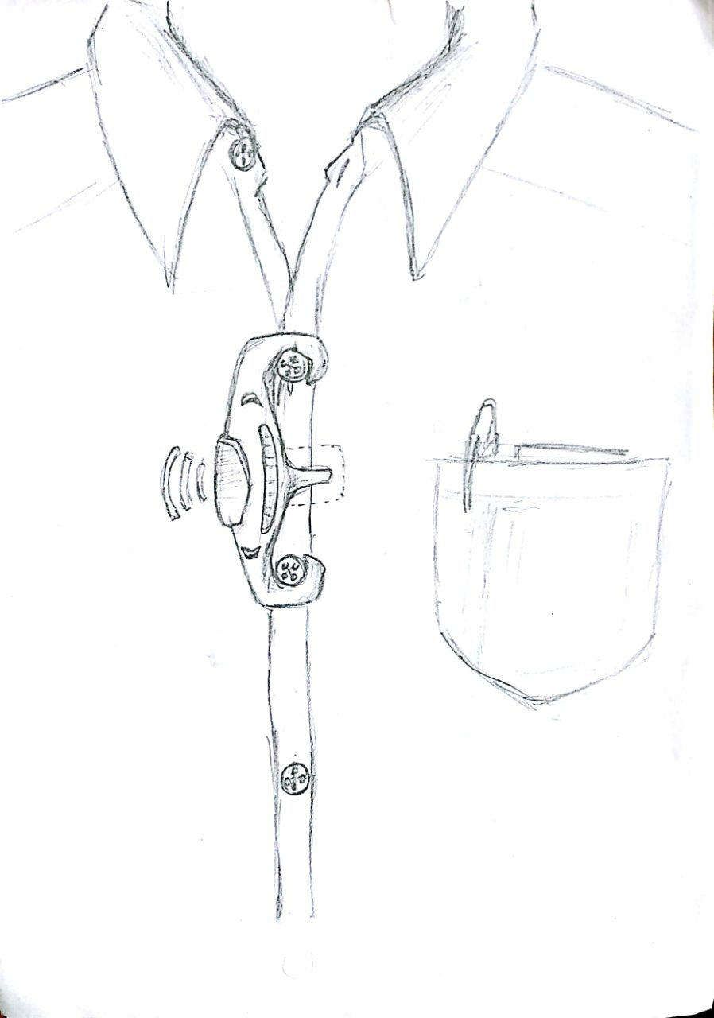
Concept 5
A wearable device keeps tracks of all the objects around us
It stores the location of the corresponding object
When asked for the object , it shows the location w.r.t reference object

Slide 16
Concept Evaluation using Pugh’s Method

Slide 17
Treating Concept 1 as DATUM (reference)
Selection Criteria | Concept 1 | Concept 2 | Concept 3 | Concept 4 | Concept 5
Engineering Characteristics: Portable Wearable device Long lasting Cost | D A T U M | + – 0 – | – – 0 + | + + 0 – | + + 0 0
Sum of +’s Sum of 0’s Sum of –’s | 0 0 0 | +1 0 –2 | +1 0 –2 | +2 0 –1 | +2 0 0
Net Score | 0 | –1 | –1 | +1 | +2
Rank | 3 | 4 | 4 | 2 | 1

Slide 18
As concept ranked 1, now we treat Concept 3 as DATUM
Selection Criteria | Concept 1 | Concept 2 | Concept 3 | Concept 4 | Concept 5
Engineering Characteristics: Portable Wearable device Long lasting Cost | 0 – 0 0 | 0 – 0 – | – – 0 – | 0 0 0 – | D A T U M
Sum of +’s Sum of 0’s Sum of –’s | 0 0 –1 | 0 0 –2 | 0 –3 0 | 0 –1 0 | 0 0 0
Net Score | –1 | –2 | –3 | –1 | 0
Rank | 2 | 3 | 4 | 2 | 1

Slide 19
Absolute Ranking:
Selection Criteria | Concept 1 | Concept 2 | Concept 3 | Concept 4 | Concept 5
Engineering Characteristics: Portable Wearable device Long lasting Cost | +1 0 +1 0 | +1 0 +1 –1 | –1 –1 +1 0 | +1 +1 0 0 | +1 +1 0 +1
Sum of +’s Sum of 0’s Sum of –’s | +2 0 0 | +2 0 –1 | +1 0 –2 | +2 0 0 | +3 0 0
Net Score | +2 | +1 | –1 | +2 | +3
Rank | 2 | 3 | 4 | 2 | 1

Slide 20
Concept Selection
From the Pugh's method Evaluation, Concept 5 is ranked first
So, we have selected the
concept 5 as our
final concept

Slide 21
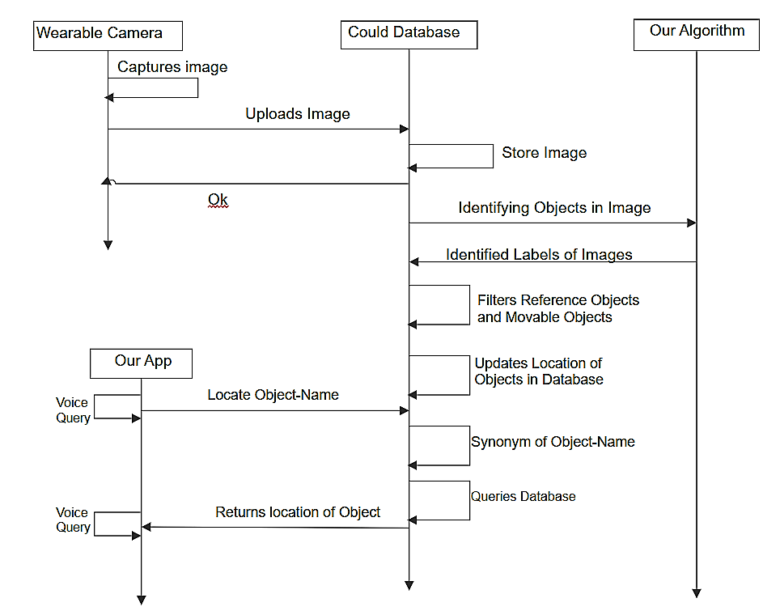
Function Flow:

Slide 22
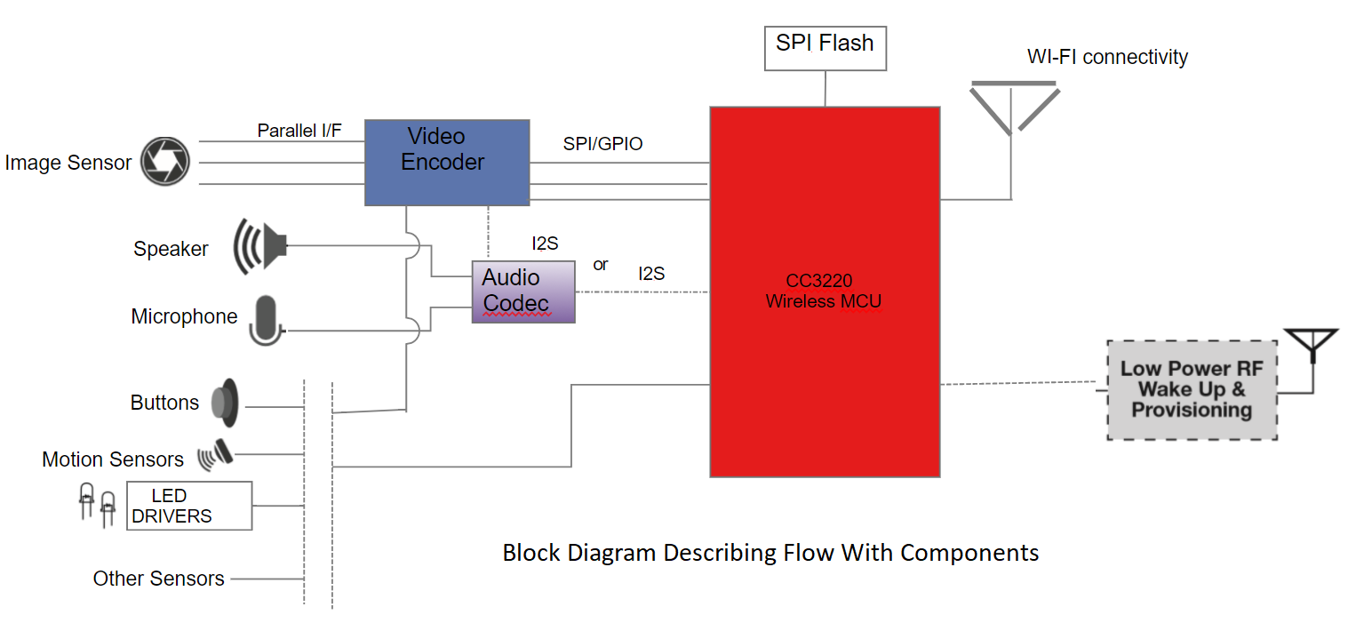
Block Diagram with components

Slide 23
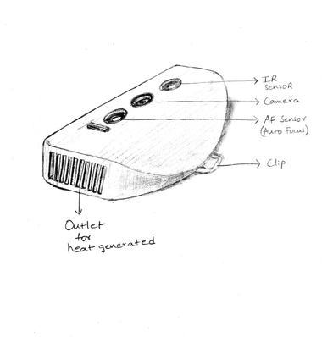
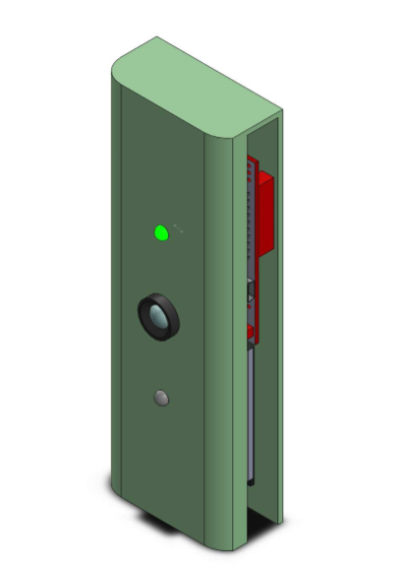
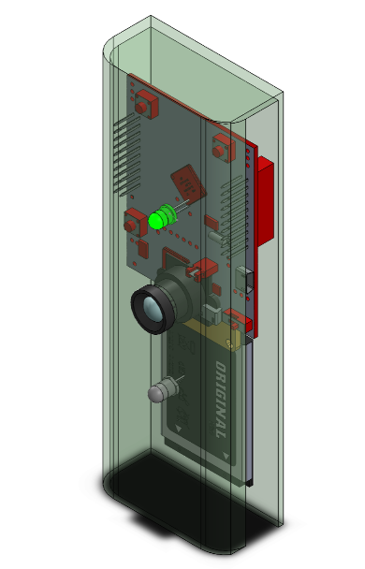
EMBODIMENT DESIGN
Design 1:

Slide 24
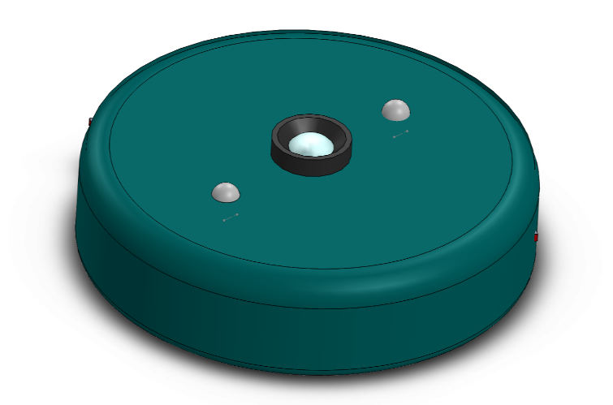
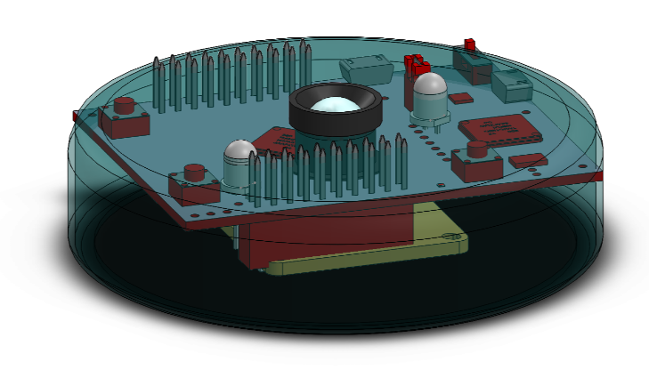
Design 2:

Slide 25
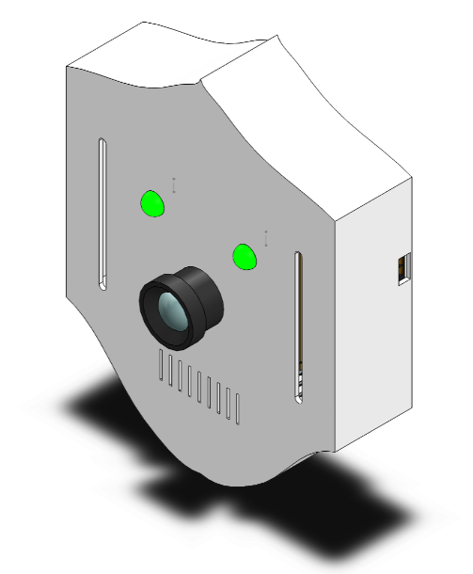
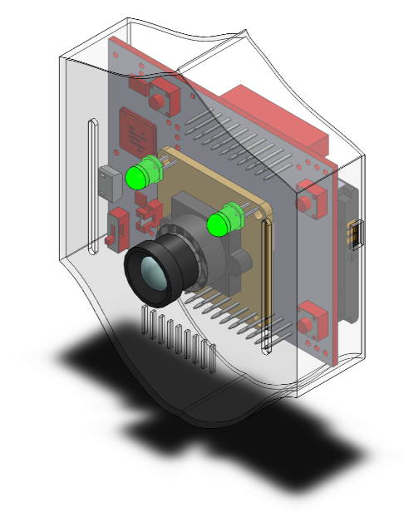
Design 3

Slide 26
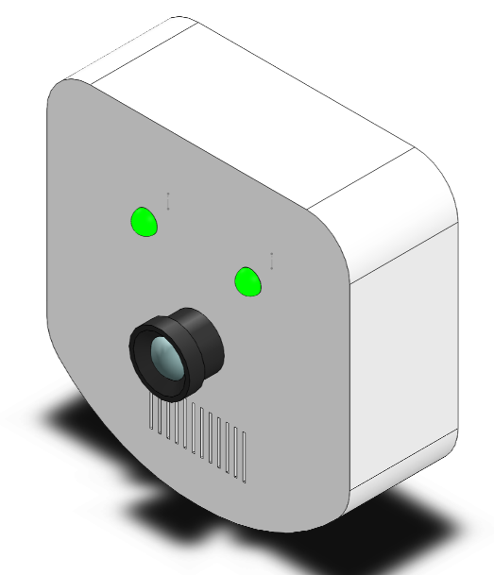
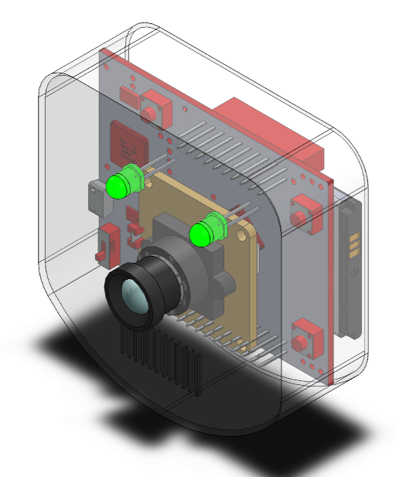
Design 4

Slide 27
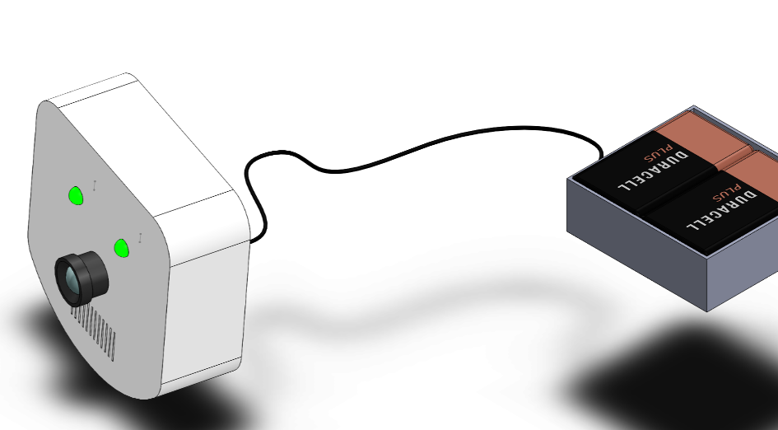
Looking the product from customers perspective , a battery module is useful in times of charge crisis.

Slide 28
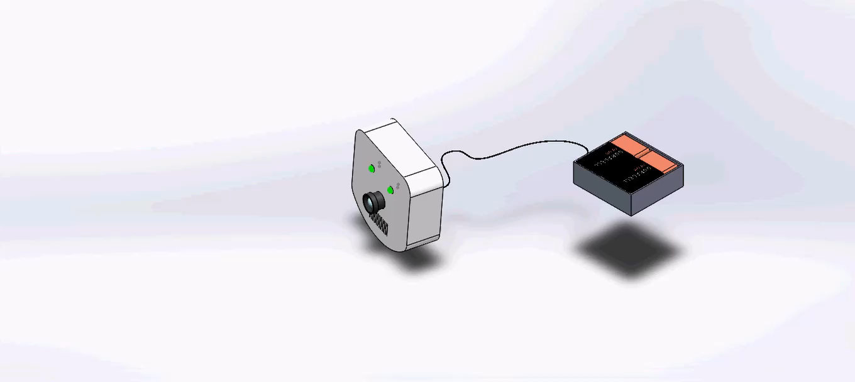
DETAIL DESIGN

Slide 29
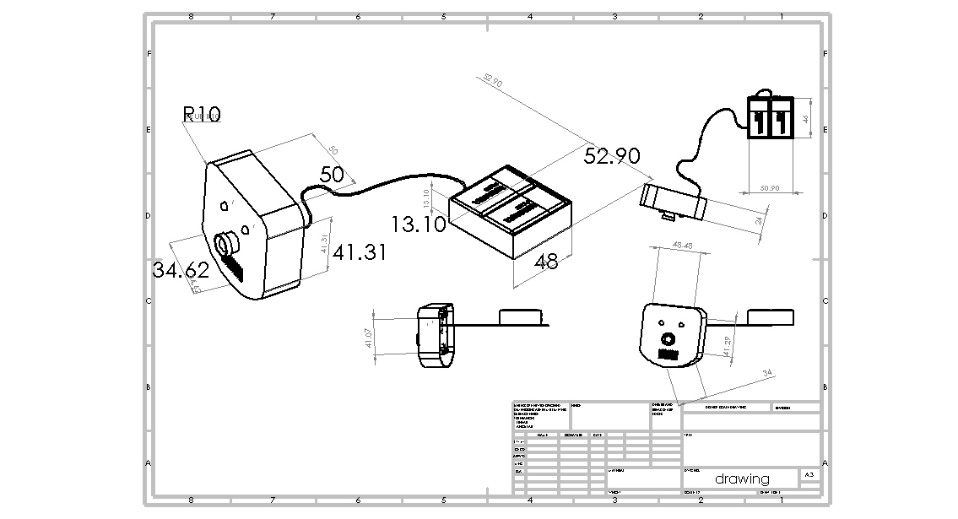
Detail Dimensioning
Height is 55 mm
Depth is 20 mm
length is 50 mm

Slide 30
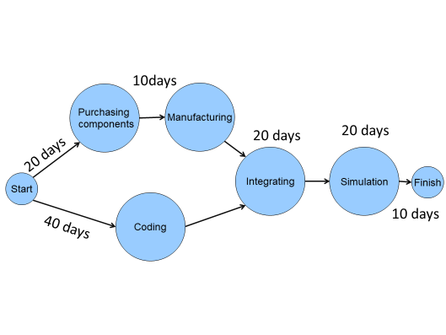
Time Estimation:

Slide 31
Cost Estimates
COMPONENTS | COST
Micro Controller Unit (1Ghz – 1.5Ghz) Camera Module (5mp – 8mp) Battery Accelerometer Device Manufacturing cost | 3000 - 3500 ₹ 1000 - 1300 ₹ 600 - 900 ₹ 350 - 500 ₹ 300 - 500 ₹
Total cost | 5250 - 6600₹

Slide 32
Material Identification
The outer body is only the part that has to be manufactured.
Material cost, ease of manufacturing, toughness etc., are taken into consideration for selecting the material.
Finally, the material Polystyrene is chosen, as it inexpensive (₹85/Kg)
It is known for its good manufacturability and high impact resistance.
s.no | Part to be manufactured | Material | Quantity | Cost
1 | Outer body | High impact Polystyrene | 500 grams | ₹45

Slide 33
Manufacturing Process
Generally, parts from plastic made up of injection moulding and casting for mass productions.
We have opted for 3D-printing, which makes it a cost effective manufacturing process.
Material cost = ₹ 45
3D Printing cost = ₹ 400
Total cost of manufacturing = ₹ 445

Slide 34

PROTOTYPE
Rendered view to visualize our product in real-world.

Slide 35
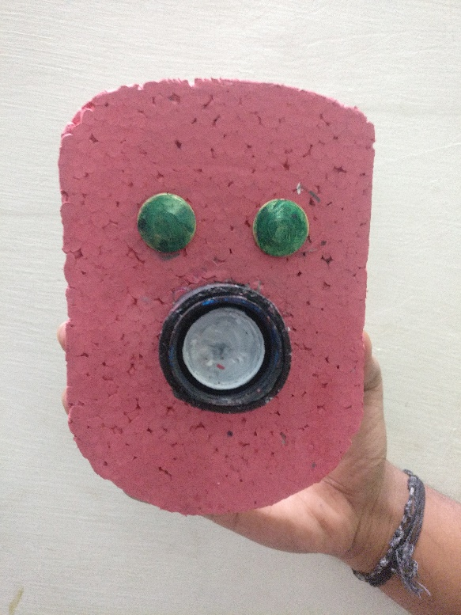
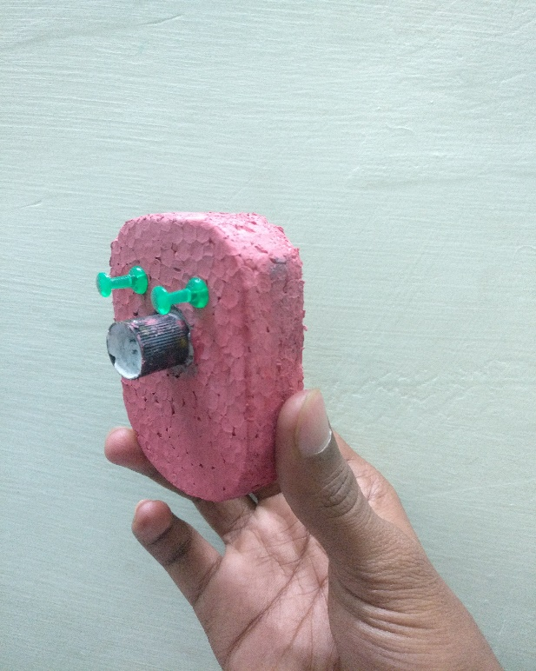
Photographs of our physical prototype

Slide 36
Concluding Remarks:
We compiled our algorithm in octave software. From that we are able to identify the images which are given as input and recognized the objects in image.
Limitations:
The images captured in the dark can not analysed.
Our product limits to the tracking capacity of 2-3 meters.
When completely discharged without knowledge of the person, it stops working.

Slide 37
Thank you

Slide 38
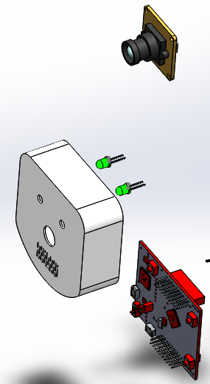
Exploded view

